Slide 1
software engineering project group no:4
Making an Application for school’s sports club

Slide 2
About our team members:
First of all I am going to introduce about our team. We are three members.
1.Asif Mohammed---F15040110- Bangladesh
2.MD Nasir Uddin ---- F15040102- Bangladesh
3.Touziat Rahman ----- F15040114 -Bangladesh

Slide 3

Our project’s name :
NUPT’S SPORTS CLUB

Slide 4

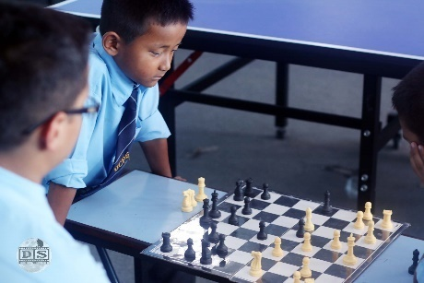


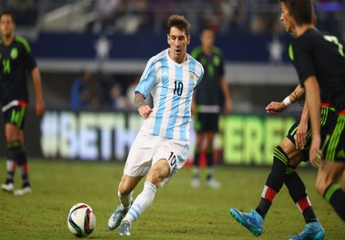
project’s AIM and ambition :
1.INCLUDING SCHOOL’S GAMING CLUB’S NAME
2.AND THEIR INFORMATIONS

Slide 5
Software structure’s demo:
NUPT’S SPORTS club
Information
image
1.soceer club
2.cricket club
3.chess club
4.badminton club
5.basketball club
Club head : Sammy bless
Contact no :109109109
Club head : Asif Mohammad
Contact no :10101010

Slide 6

Materials:
We will use to create the website-
Java
Photoshop
Android studio
And if we need more materials for creating the website successfully , we will use that later.

Slide 7
Our group plan :
GROUP WORK
FIX A TIME FOR MEETING

Slide 8
Our Prospects :
LEARNING
STRUGGLEING
AND PREPARE FOR THE FUTURE

Slide 9
Thanks a lot my dear teacher and fellow students …….

